Slide 1
SOCIAL INSTITUTIONS: RELIGION
IMRAN AHMAD SAJID

Slide 2
Religion [is a] sacred Engagement with that which is believed to be a spiritual reality.
In all cultures, human beings make a practice of interacting with what are taken to be spiritual powers.
These powers may be in the form of gods, spirits, ancestors, or any kind of sacred reality with which humans believe themselves to be connected.
Sometimes a spiritual power is understood broadly as an all-embracing reality (as in Pantheism), and sometimes it is approached through its manifestation in special symbols.
It may be regarded as external to the self, internal, or both. People interact with such a presence in a sacred manner—that is, with reverence and care.
Religion is the term most commonly used to designate this complex and diverse realm of human experience.
William E. Paden
Microsoft ® Encarta ® 2009. © 1993-2008 Microsoft Corporation. All rights reserved.

Slide 3
OGBURN
Religion is an attitude towards super-human powers.
A.W. GREEN
Religion is a system of belief and symbolic practices and objects governed by faith rather than by knowledge, which relates man to an unseen supernatural realm beyond the known and beyond the controllable.
EMILE DURKHEIM
Religion is a unified system of beliefs and practices related to sacred things.

Slide 4
MACIONIS
Profane: (outside the temple), ordinary elements of everyday life.
Sacred: extraordinary, inspiring awe and reverence.
Religion is a social institution involving beliefs and practices based on recognizing the sacred (p.492).

Slide 5
Religion = Mazhab مذہب
مذہب: راستہ، طریقہ (فیروز الغات)
مسلک: قاعدہ، راستہ، دستور
قاعدہ: رسم، قانون، ضابطہ، دستور
رسم: نقش، تحریر، نشان، چال چلن، طور طریق، دستور، رواج،

Slide 6
REZA ASLAN
[Religion is] a language made up of symbols and metaphors that allows people to communicate, to themselves and to others, the ineffable experience of faith.
FAITH: belief in, devotion to, or trust in somebody or something, especially without logical proof

Slide 7
Elements of Religion
Religious Beliefs
Religious Rituals
Religious Symbols
Sacred Objects
Sacred History
Sacred Spaces
Renewal Observance

Slide 8
1.Beliefs
Religious Beliefs:
religious beliefs are statements to which members of a particular religion adhere.
(i)Nature of the universe, (ii) the origin of the world and its people, (iii) purpose of life, (iv) existence after death.
e.g. Creation of Adam and Eve as the foundation of human specie on earth is a belief.
Faith:
Faith, belief based on conviction rather than on scientific evidence.

Slide 9
2. Religious Rituals
Rituals are formal, ceremonial behaviour.
Religious rituals are practices required or expected of members of a faith.
Rituals usually honour the divine power worshiped by believers: they also remind adherents of their religious duties and responsibilities.
Rituals strengthen beliefs.
E.g. Prayers and Hujj by Muslims, are rituals.

Slide 10
Ritual is a form of communication in its own right. Rituals involve performance and symbolic bodily actions, displayed in a tangible, visible way. They have the power to focus experience and thus function to intensify the sense of the sacred.

Slide 11
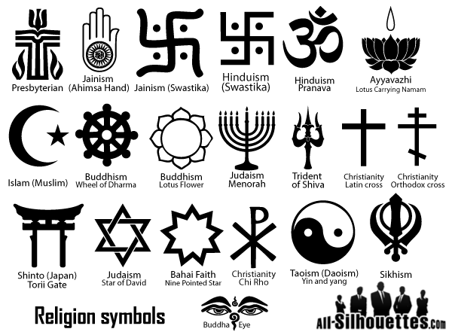
3. Symbols
Something that represents something else. It has meaning for people socialized in the same culture.

Slide 12
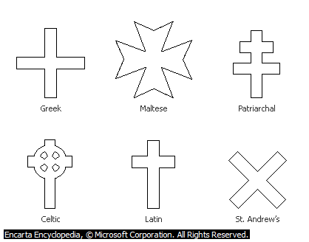
4. Sacred Objects
Sacred objects are objects considered as holy by adherents of a religion.
E.g. Quran for Muslims: Bible and Cross for Christians; Cow for Hindus; beats for muslims

Slide 13
5. Sacred Histories
Most religious systems are organized around certain past events and models.
Each religion has its own account of the history of the world—the great time when gods, creators, sages, ancestors, saviors, founders, or heroes established or revealed the essential elements of the religion.
These collective memories are ordinarily preserved in carefully maintained oral traditions or in the classic accounts known as scriptures or sacred writings

Slide 14
6. Sacred Spaces
Religions not only create sacred times that define the calendar and occur throughout the year, intersecting with ordinary time, they also establish special places that localize the sacred in the midst of ordinary space.
Sometimes these are places of natural beauty or imposing power, such as mountains, caves, or rivers.
They may also be sites that commemorate great religious events of the past—for example, the birthplace of the Hindu god Krishna; the site of the Buddha’s enlightenment; or the spot where Muhammad is believed to have journeyed to heaven (memorialized by the Dome of the Rock in Jerusalem).

Slide 15
7. Renewal Observance
Religions provide for continual renewal by setting aside special times for their adherents to recollect and demonstrate what they hold sacred.
These occasions may take place annually, monthly, weekly, daily, or even hourly.
Muslims are expected to pause for prayer at five different times every day, and during the holy month of Ramadan—which honors the month when the Qur'an was first revealed—they are expected to observe a fast every day from sunrise to sunset.

Slide 16
Functions of Religion
Emile Durkheim identified three major functions of religion that contribute to the operation of society:
Establishing social cohesion*
Promoting social control
Providing meaning and purpose
*joining or working together

Slide 17
01. Establishing social cohesion
Religion unites people through shared symbolism, values, and norms.
Religious thought and ritual establish rules of fair play, organizing our social life.

Slide 18
02. Promoting Social Control
Every society uses religious ideas to promote conformity.
By defining God as a “judge”, many religions encourage people to obey cultural norms.
Religion can also be used to back-up the power of political systems.
In medieval Europe, for example, monarchs claimed to rule by “divine right”, so that obedience was seen as doing God’s will. Even today, our leaders ask for God’s blessing, implying that their efforts are right and just.
واماالسائل فلا تنھر۔

Slide 19
You are not a Drop in an Ocean. You are an entire Ocean in a Drop.
03. Providing meaning and purpose
Religious belief offers the comforting sense that our brief lives serve some greater purpose.
Strengthened by such beliefs, people are less likely to despair in the face of change or even tragedy.
For this reason, we mark major life course transitions—including birth, marriage, and death—with religious observances.

Slide 20
Other Functions of Religion
Religion spread education
Religion reduces frustration
Religion encourages benevolence/Welfare
Religion creates a sense of self-importance
Religion encourages social values
Religion and tolerance
Religion and culture
Religion and non-violence
Religion and civilization
Religion and integration

Slide 21
Thank You

